Slide 1
HOL-2

Slide 2
Agenda
Cloning Virtual Machines and Using Templates
Using Search to Find Objects Quickly
VMware Tagging | Assign Tag
vSphere Availability
Distributed Resource scheduler (DRS)

Slide 3
Cloning Virtual Machines and Using Templates

Slide 4
Cloning
Cloning a virtual machine can save time if you are deploying many similar virtual machines. You can create, configure, and install software on a single
virtual machine. You can clone it multiple times, rather than creating and configuring each virtual machine individually.

Slide 5
Template
A template is a master copy of a virtual machine that you can use to create and provision virtual machines. Creating a template can be useful when you need to deploy multiple virtual machines from a single baseline but want to customize each system independently of the next. A common value point for using templates is to save time.
If you have a virtual machine that you will clone frequently, make that virtual machine a template, and deploy your virtual machines from that template.

Slide 6
Clone an existing Virtual Machine to a Template and deploy a new Virtual Machine from that Template

Slide 7
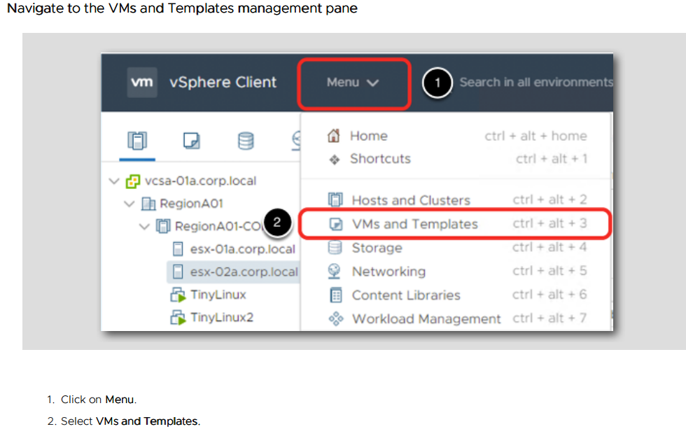
Steps

Slide 8
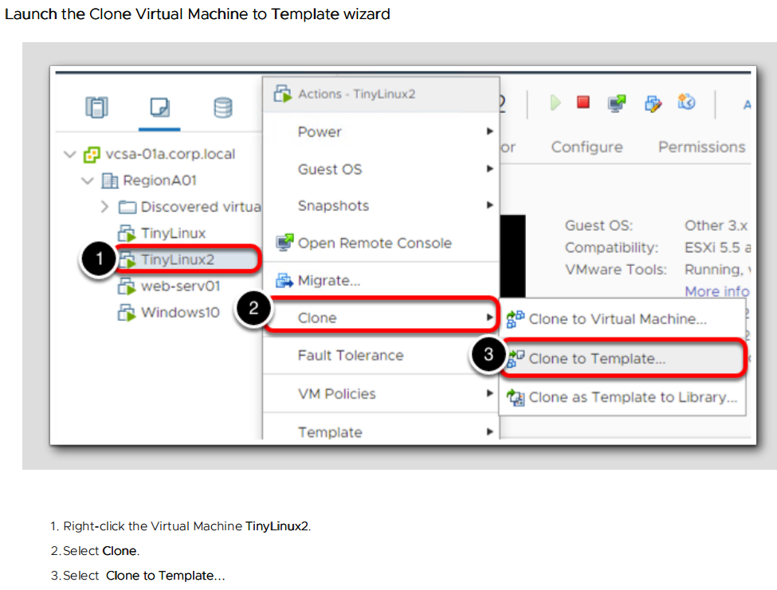

Slide 9
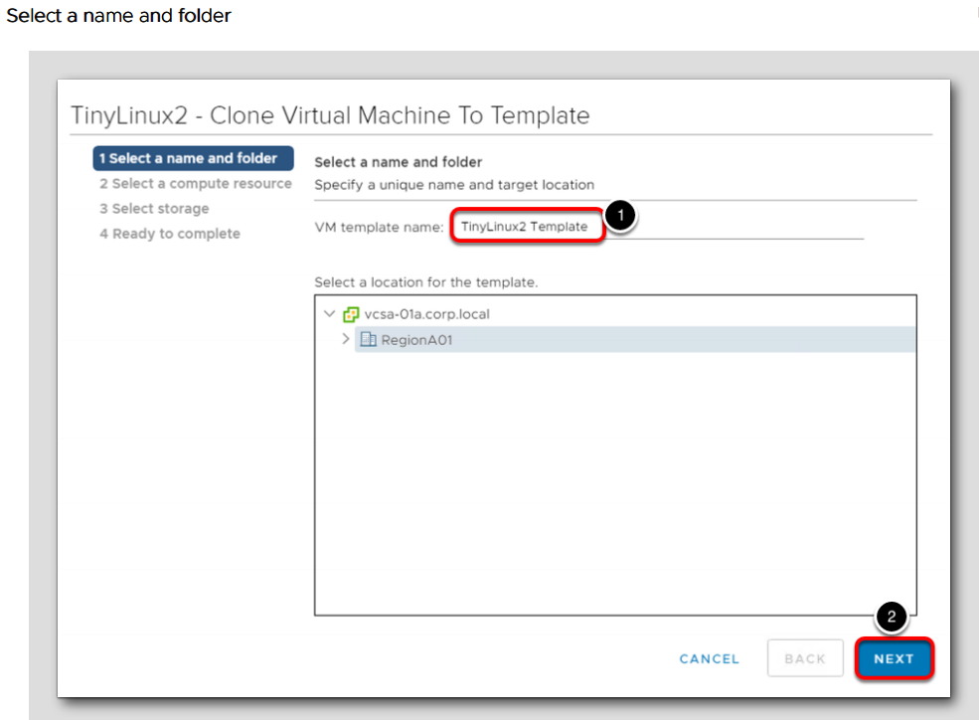
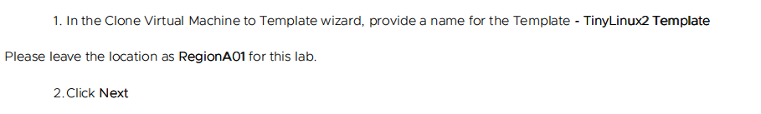

Slide 10
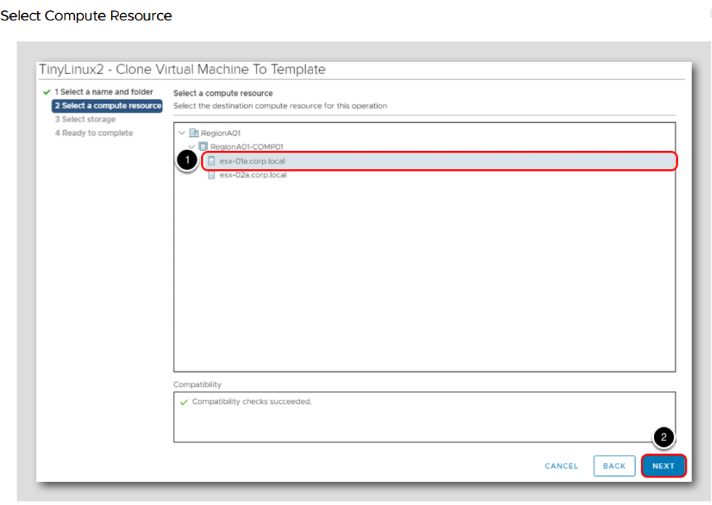
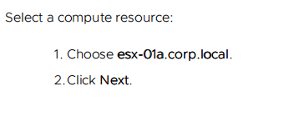

Slide 11
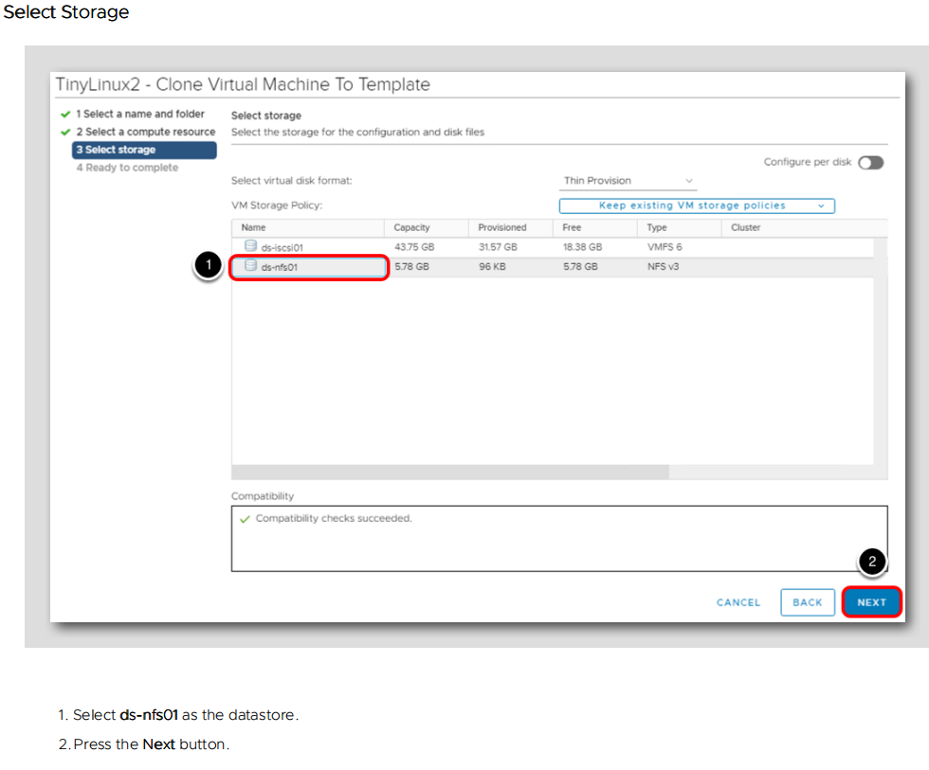

Slide 12
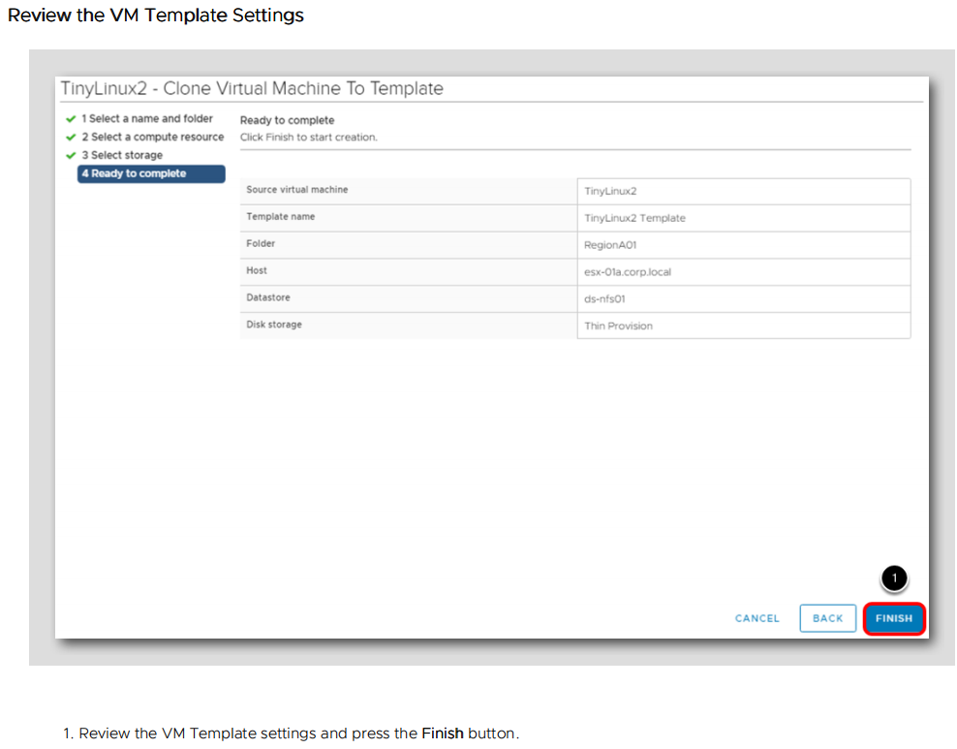

Slide 13
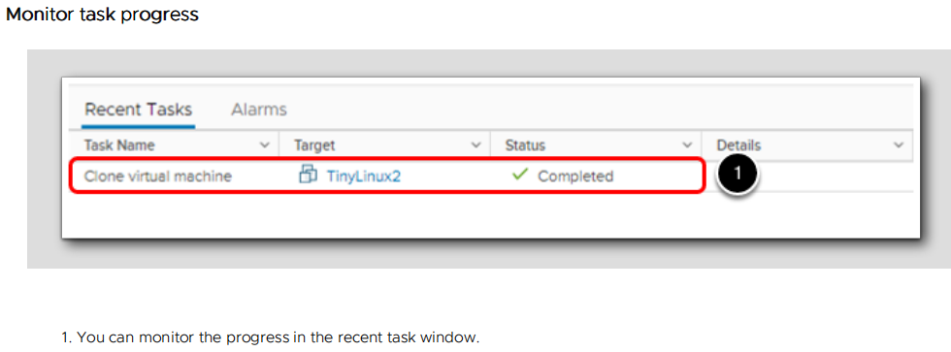

Slide 14
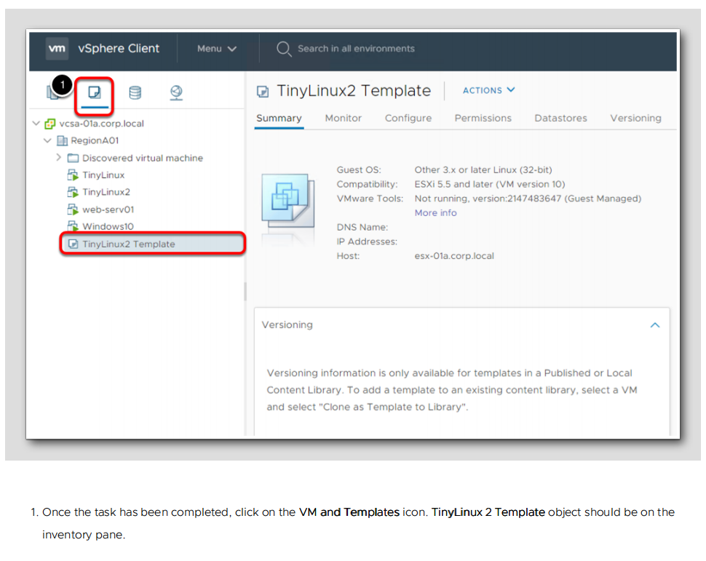

Slide 15
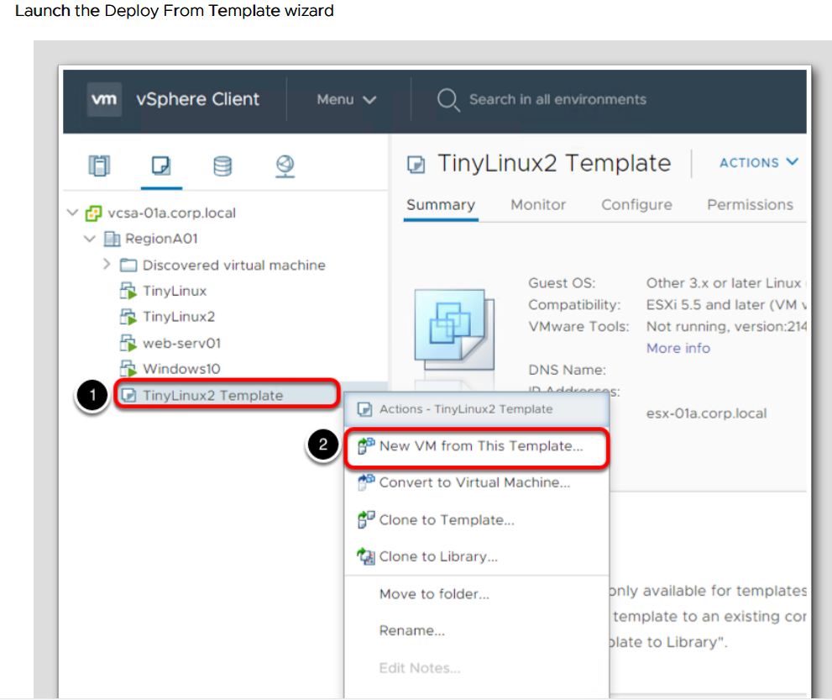


Slide 16
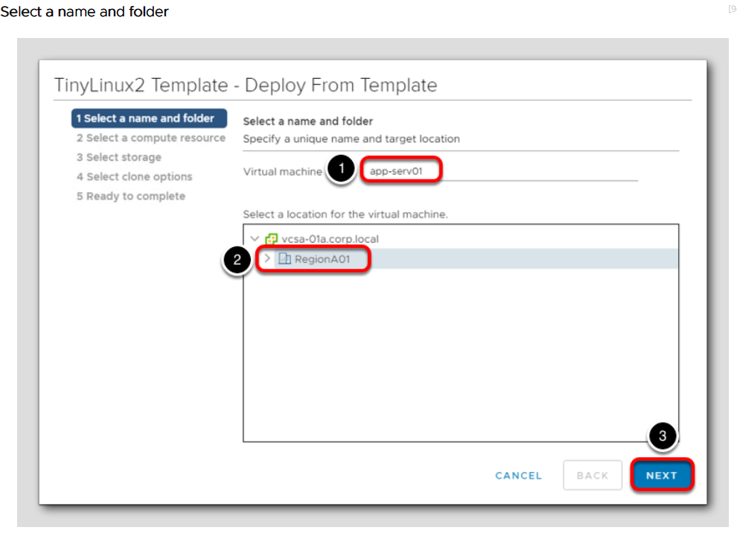


Slide 17
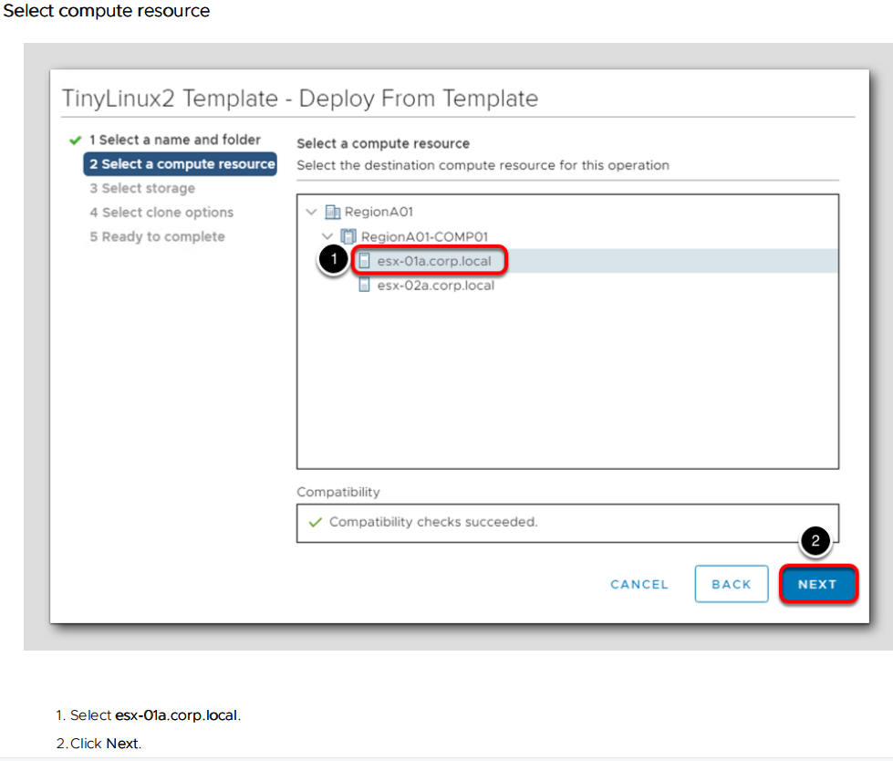

Slide 18
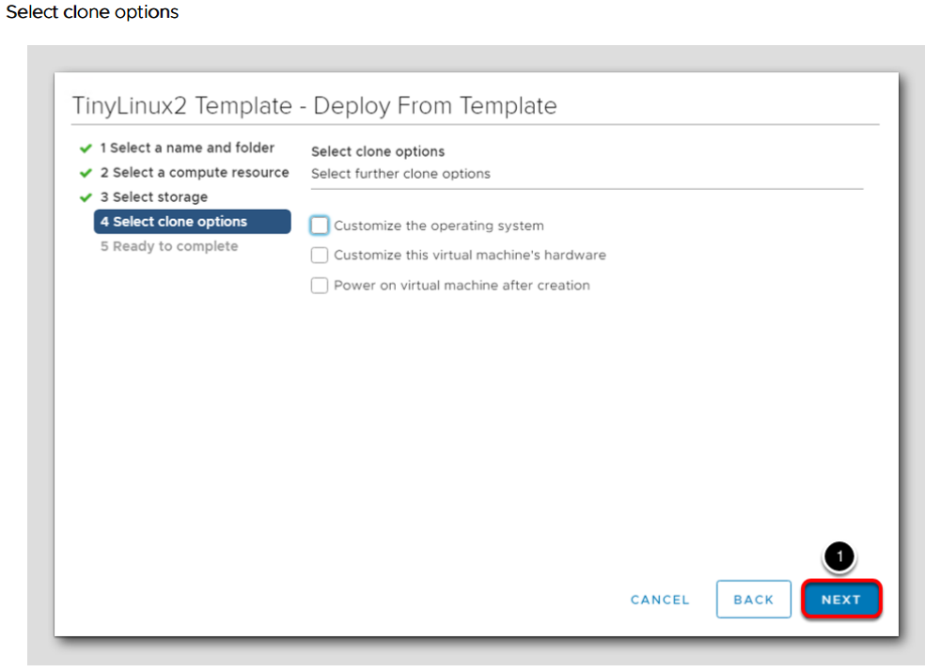
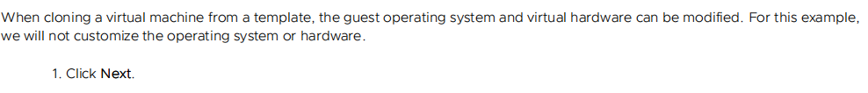

Slide 19
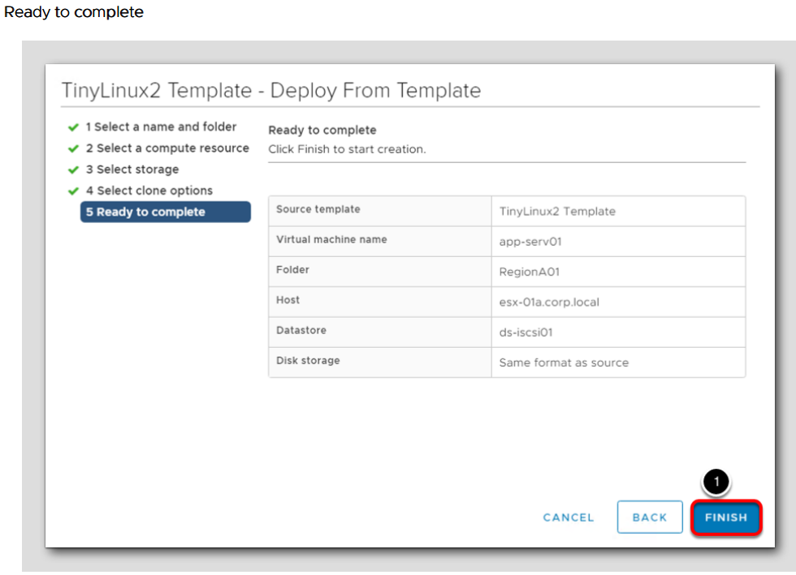

Slide 20
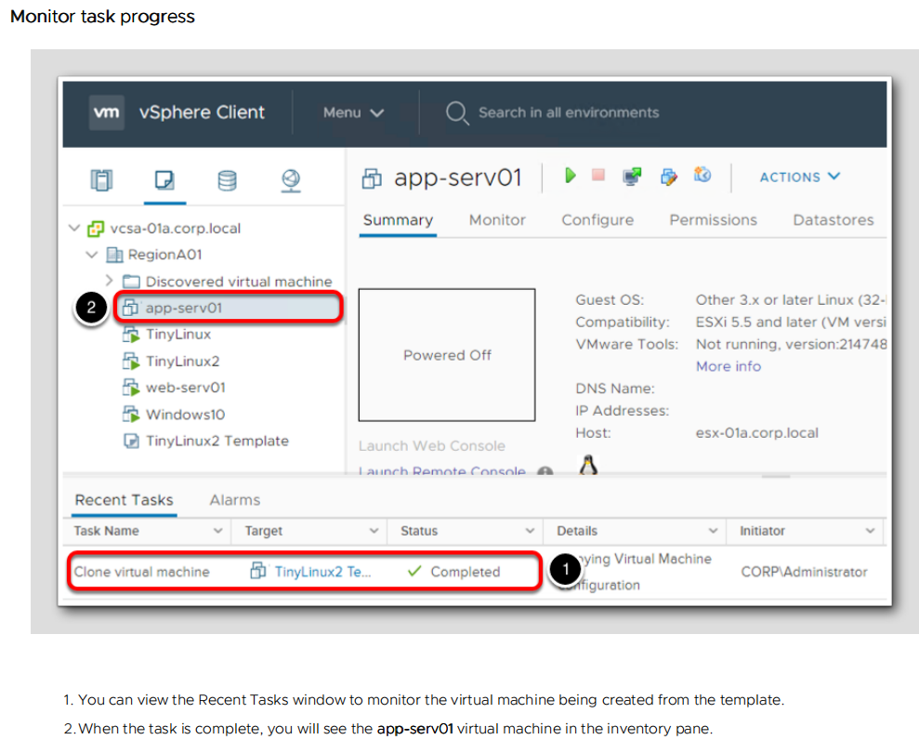

Slide 21
Using Search to Find Objects Quickly

Slide 22
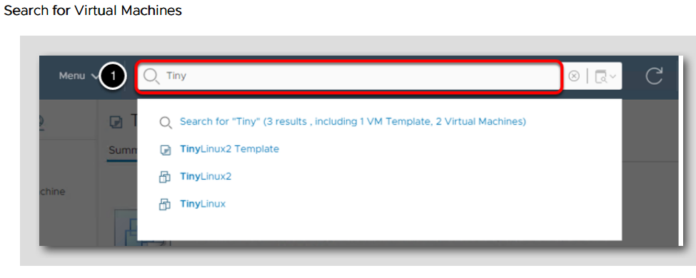
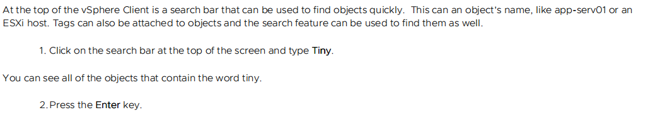

Slide 23
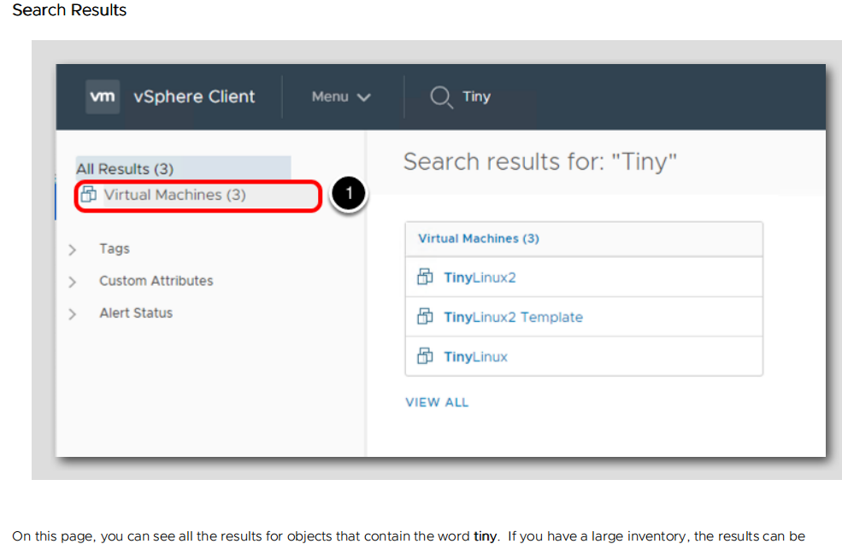

Slide 24
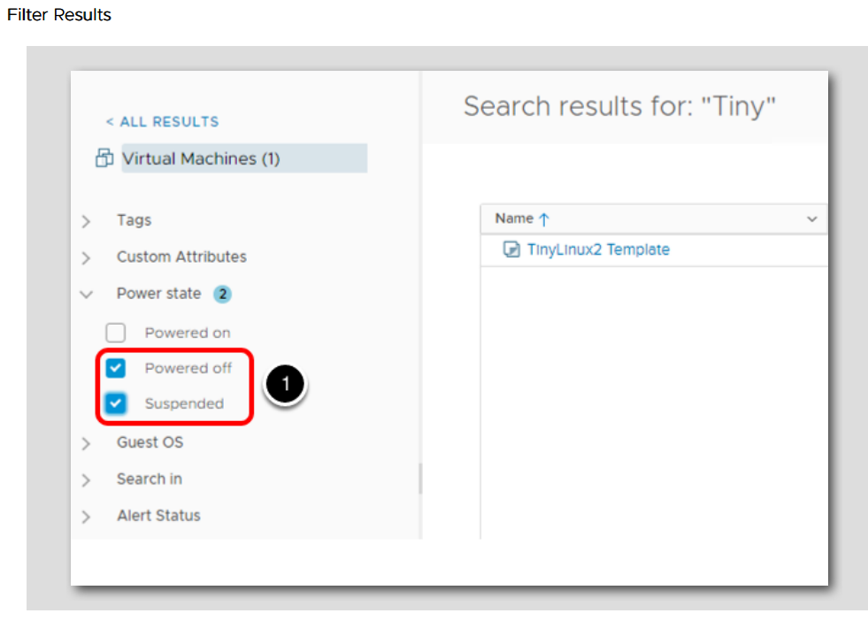
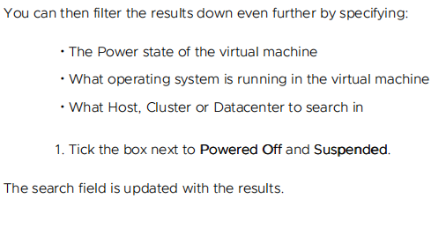

Slide 25
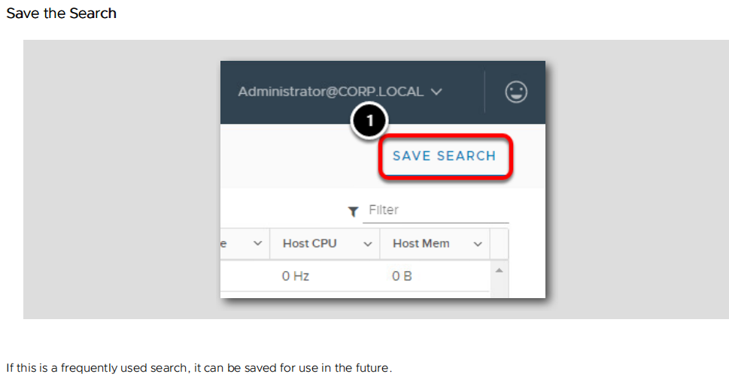

Slide 26
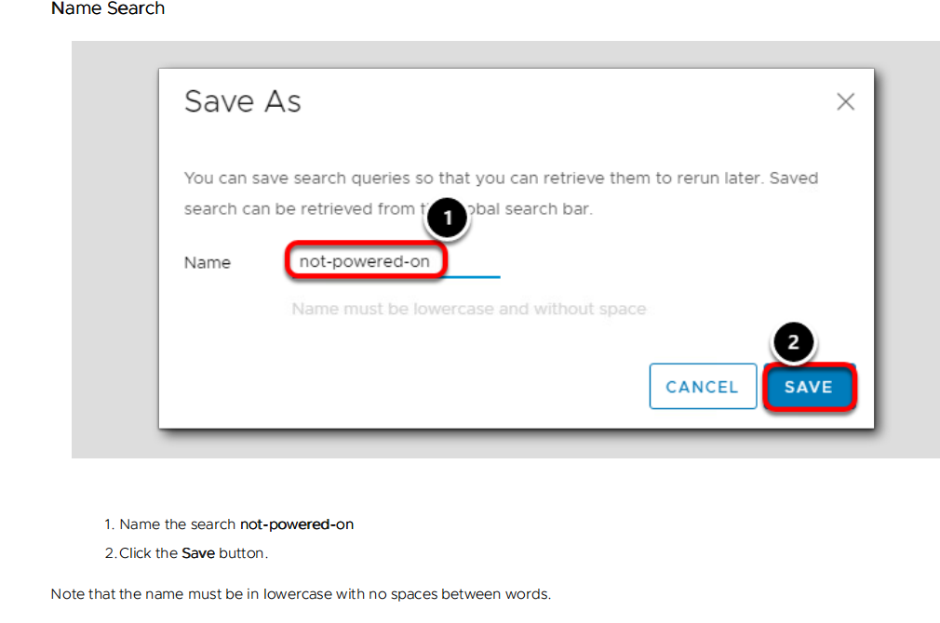

Slide 27
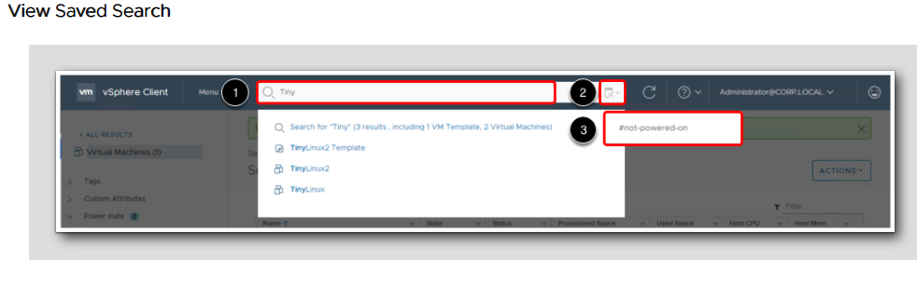


Slide 28
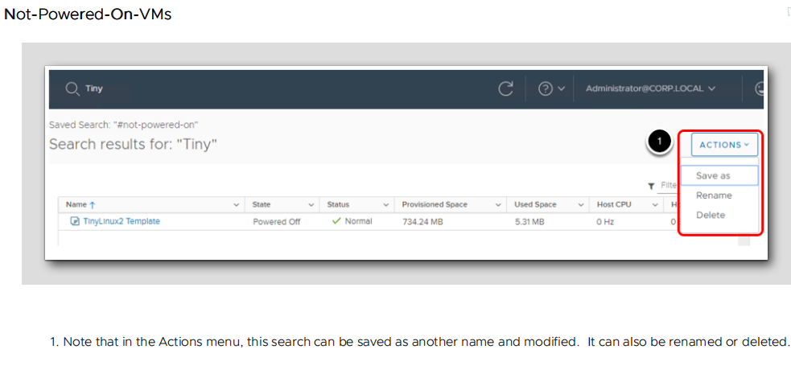

Slide 29
VMware Tagging

Slide 30
Tags and attributes allow you to attach metadata to objects in the vSphere inventory to make it easier to sort and search for these objects.
A tag is a label that you can apply to objects in the vSphere inventory. When you create a tag, you assign that tag to a category. Categories allow you to group related tags together. When you define a category, you can specify the object types for its tags, and whether more than one tag in the category can be applied to an object.
For example, if you wanted to tag your virtual machines by guest operating system type, you can create a category called operating system. You can specify that it applies to virtual machines only and that only a single tag can be applied to a virtual machine at any time. The tags in this category might be Windows, Linux, and Mac OS.

Slide 31
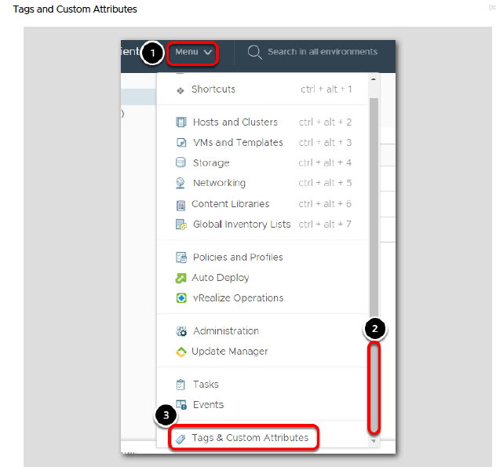

Slide 32
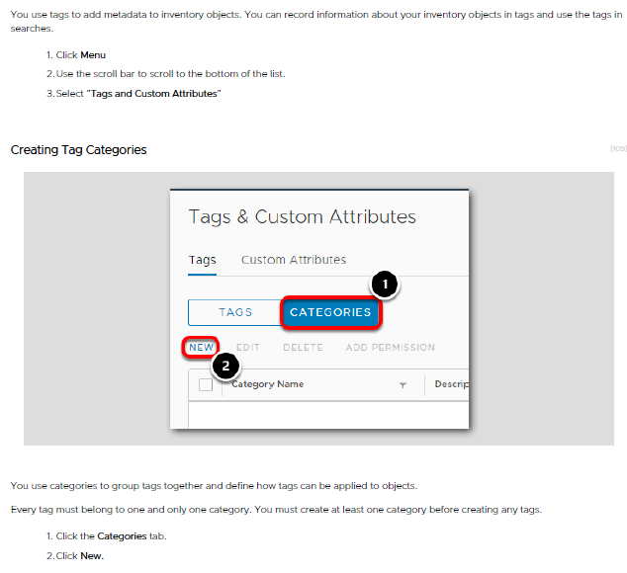

Slide 33
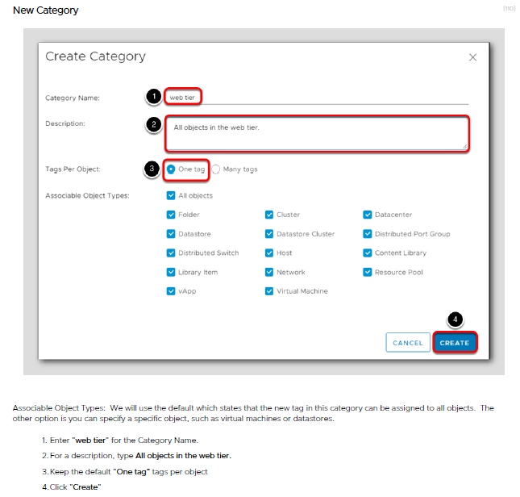

Slide 34
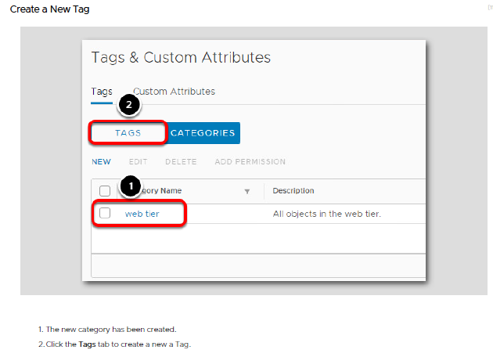

Slide 35
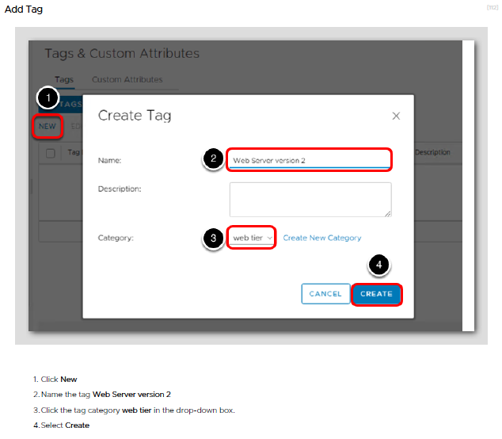

Slide 36
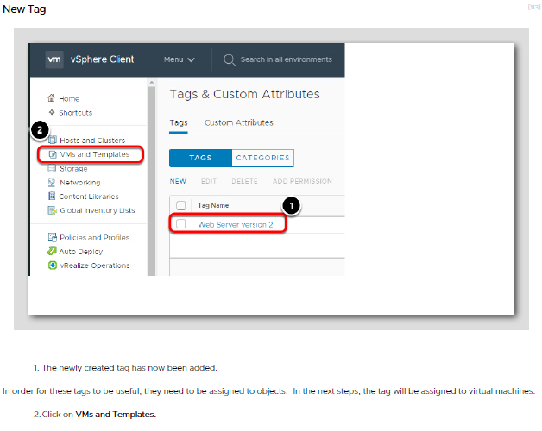

Slide 37
Assign Tag

Slide 38
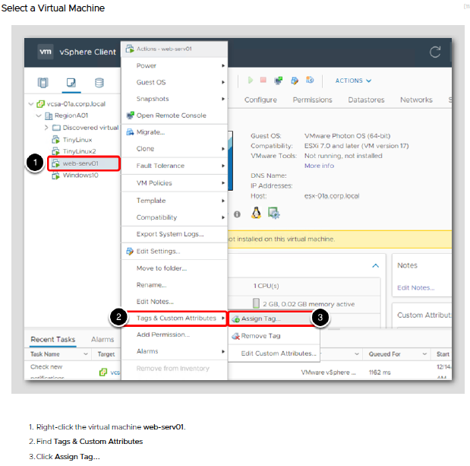

Slide 39
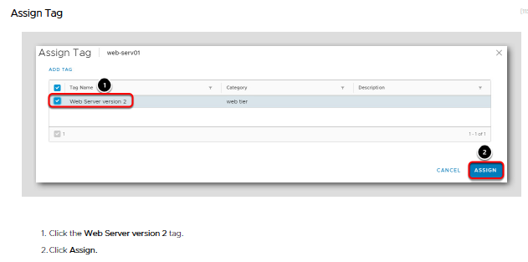

Slide 40
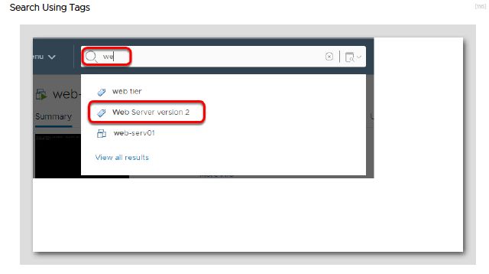

Slide 41
vSphere Availability
vSphere Availability describes solutions that provide business continuity, including how to establish vSphere® High Availability (HA) and vSphere Fault Tolerance.
vSphere HA provides high availability for virtual machines by pooling the virtual machines and the hosts they reside on into a cluster. Hosts in the cluster are monitored and in the event of a failure, the virtual machines on a failed host are restarted on alternate hosts.
https://docs.vmware.com/en/VMware-vSphere/6.7/com.vmware.vsphere.avail.doc/GUID-33A65FF7-DA22-4DC5-8B18-5A7F97CCA536.html

Slide 42
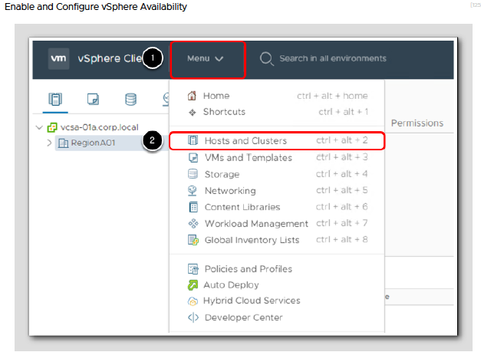

Slide 43
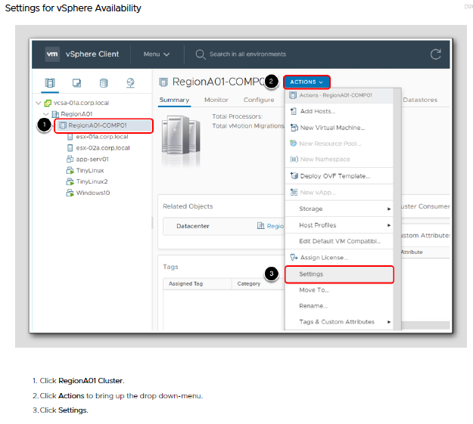

Slide 44
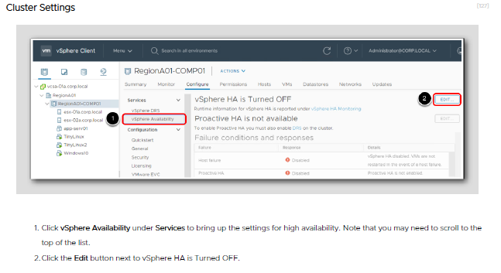

Slide 45
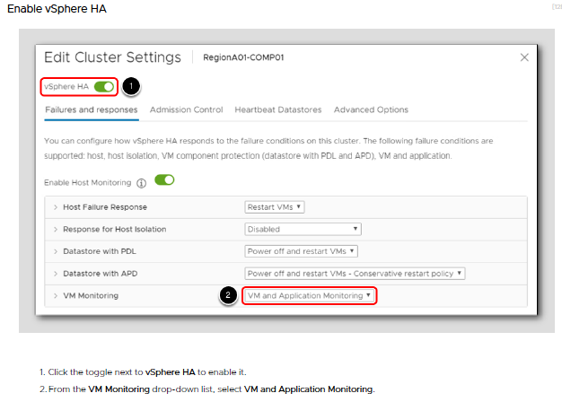

Slide 46
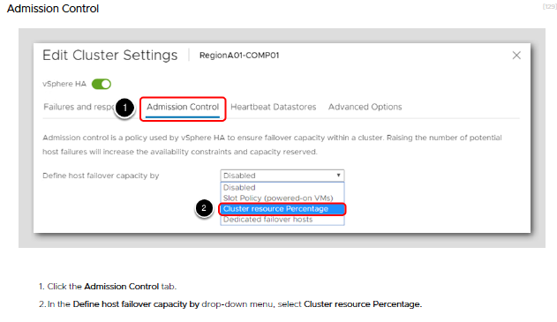

Slide 47
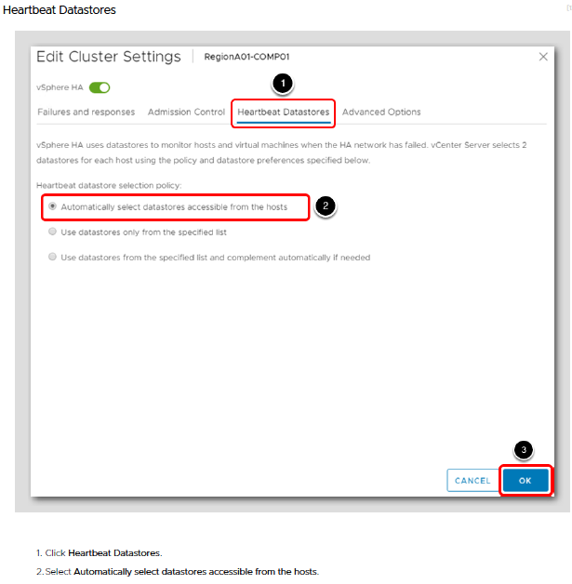

Slide 48
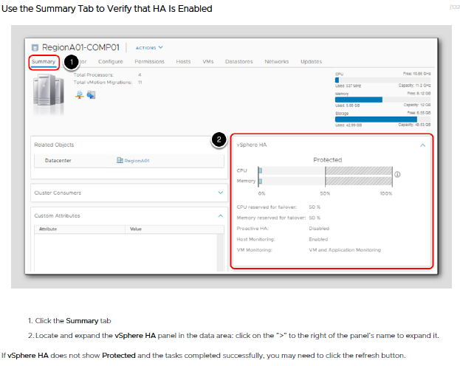

Slide 49
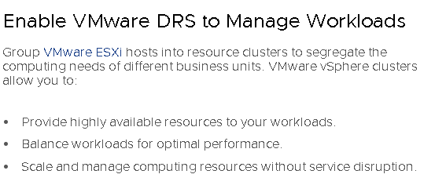
Distributed Resource scheduler (DRS)
Distributed Resource scheduler (DRS) is a type of VMware vSphere cluster that provides load balancing by migrating VMs from a heavily loaded ESXi host to another host that has enough computing resources, all while the VMs are still running. This approach is used to prevent overloading of ESXi hosts. Virtual machines can have uneven workloads at different times, and if an ESXi host is overloaded, performance of all VMs running on that host is reduced.

Slide 50
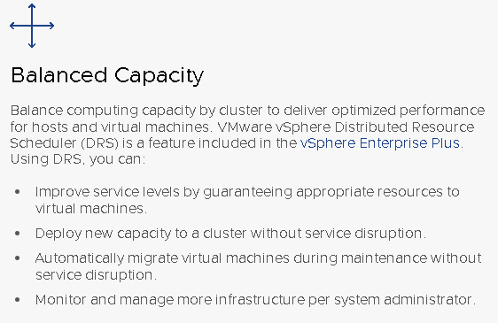
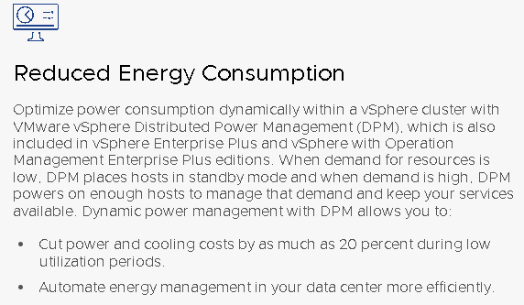
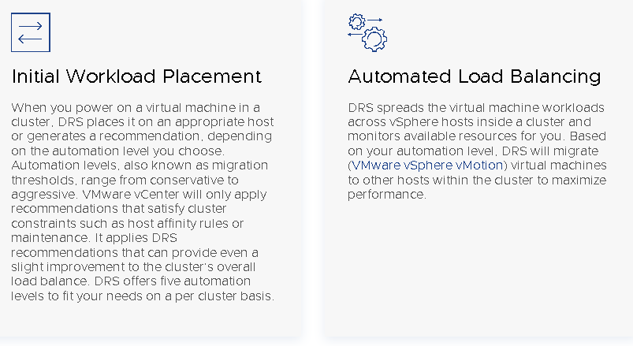
Features

Slide 51
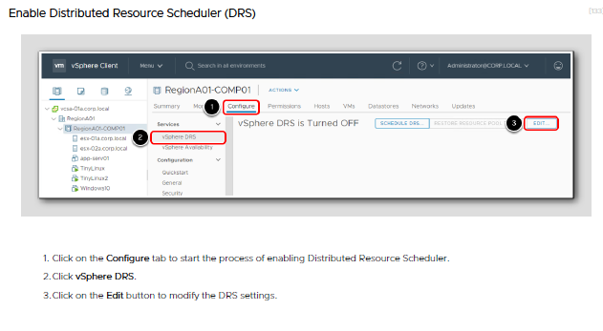

Slide 52
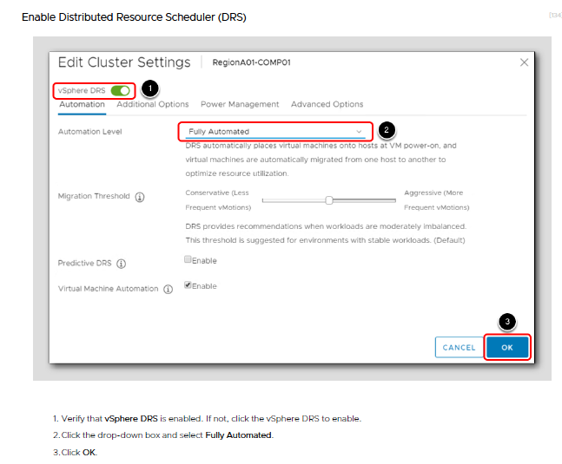

Slide 53
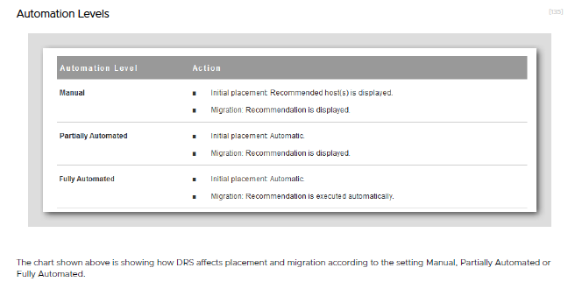

Slide 54
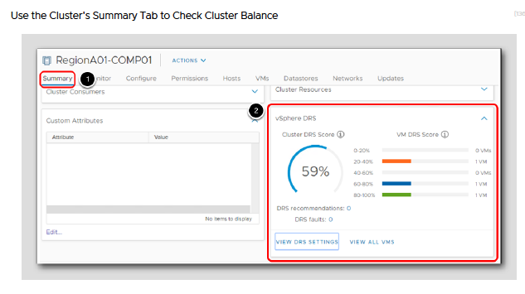
Notes:
124

Slide 55
See you in HOL-3

